Slide 1

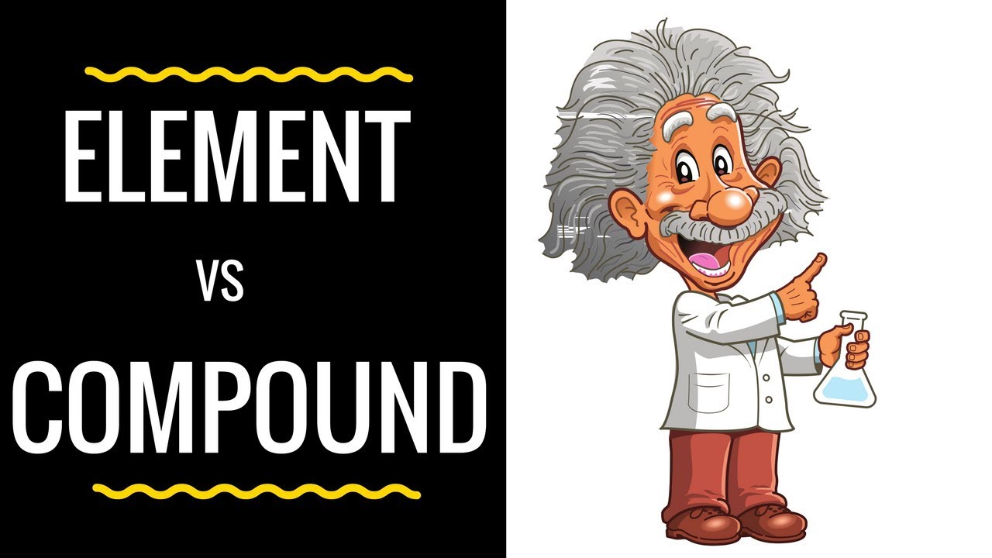
ELEMENTS,COMPOUNDS AND MIXTURES
CLASS - VIII

Slide 2
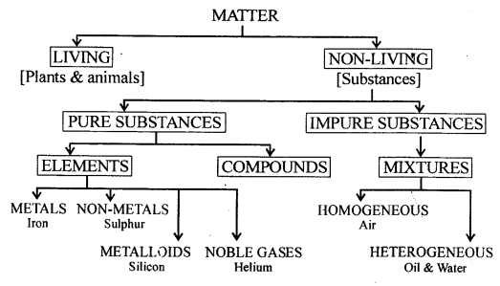
CHEMICAL CLASSIFICATION OF MATTER

Slide 3
PURE SUBSTANCES
It is a homogenous material which contains particle of only one kind and has a definite set of properties.
Example- Iron,Sodium,Sulphur,Hydrogen,Water etc.
Note - All homogenous material are not pure substances.
Characteristics of a pure substance
Homogenous in nature.
Has a definite set of properties.
The composition of pure substance cannot be changed by physical methods.
PURE SUBSTANCES
ELEMENTS
COMPOUNDS

Slide 4
ELEMENTS
It is a pure substance which can not be broken down into still simpler substances by any known physical or chemical method. It consists of only one kind of atom.
(A) METALS
State: Metals are solids at room temperature with the exception of Mercury, which is liquid at room temperature (Gallium is liquid on hot days).
Lustre: Metals have the quality of reflecting light from their surface and can be polished.
Sonorous: Metals produce a sound on striking.
Malleability: Metals have the ability to withstand hammering and can be made into thin sheets known as foils.
Ductility: Metals can be drawn into wires.
(Zinc is neither malleable nor ductile).
Hardness: All metals are hard except Sodium and Potassium, which are soft and can be cut with a knife
Conduction: Metals are good conductors because they have free electrons. Silver and copper are the two best conductors of heat and electricity. Tungsten is a poor conductor of electricity. Lead is the poorest conductor of heat.
Melting and Boiling Points: Metals have high melting and boiling points. Tungsten has the highest melting and boiling points whereas Mercury has the lowest. Sodium and Potassium also have low melting points.

Slide 5
(B) NON METALS
State: Non metals exist in all three states of matter.
Lustre: Non metals do not have bright lustre. (Graphite and Iodine have lustre)
Malleability: Non metals are not malleable.
Ductility: Non metals are not ductile.
Conduction: Non metals are poor conductors of heat and electricity. (Graphite is the good conductor of heat and electricity)
Melting and Boiling Points: Non metals have low melting and boiling point.
Sonorous: Non metals are non sonorous.
(C) METALLOIDS
(D) NOBLE GASES
The elements which show the properties of metals as well as non metals are called metalloids.
Examples- Arsenic,Antimony.Bismuth,Germanium etc.
Gaseous in nature
Chemically less reactive
Occur in free state in air or atmosphere in small amounts(rare gases)
They exist as monoatomic molecules.
Example- Neon,Argon,Krypton,Xenon,Radon etc

Slide 6
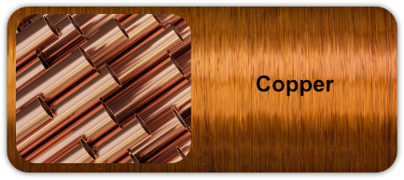
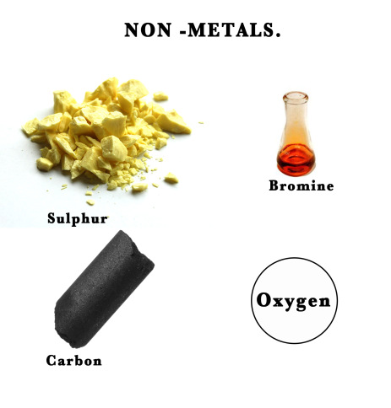
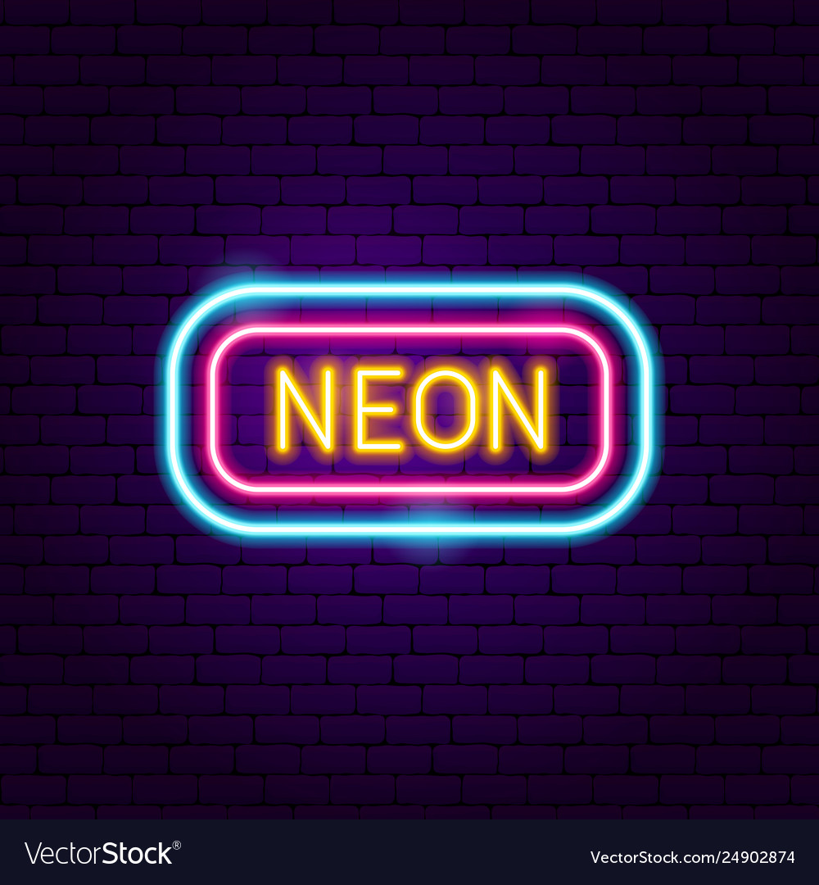

Slide 7
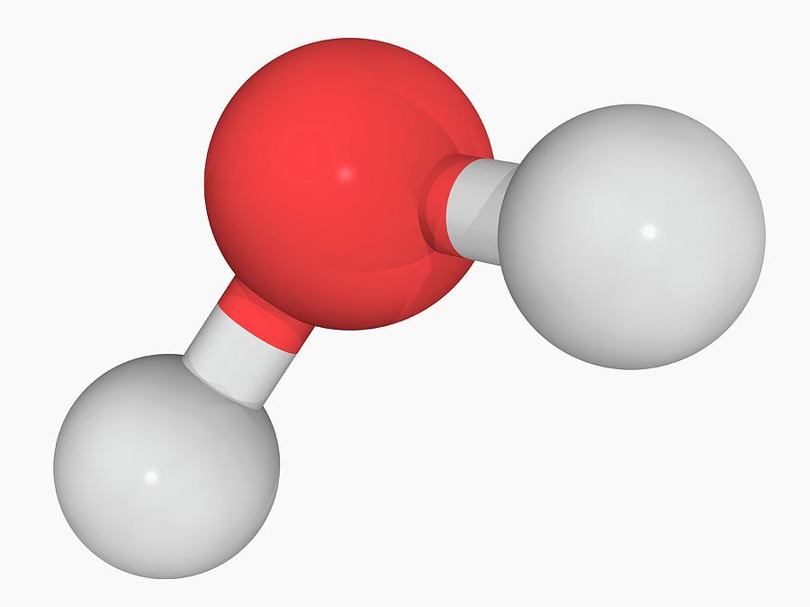
COMPOUNDS
Compound is a pure substance which is made up of two or more elements combined chemically in a fixed ratio by weight and it can be broken down into elements by chemical methods only.
Characteristics of a compound
→It is homogeneous in nature.
→It has a fixed composition by weight.
→A compound is formed from its elements by a chemical reaction only.
→The constituent elements of a compound cannot be separated by physical methods.
→Chemical compound can be broken into its component elements by chemical methods only.
→The properties of a compound are different from those of constituent elements.
→The formation of a compound from its elements is accompanied by energy changes.
Examples
1. Exothermic reaction.
2. Endothermic reaction.
→A compound has its own characteristic melting point and boiling point.

Slide 8
MIXTURES
Mixture is a material obtained by mechanically mixing two or more substances (elements/compounds) in any proportion.
Example- Air
TYPES
1.HOMOGENOUS MIXTURES
2.HETEROGENOUS MIXTURES
HOMOGENOUS MIXTURES
HETEROGENOUS MIXTURES
A mixture in which the different constituents are mixed uniformly and has a uniform composition throughout is called homogeneous mixture.
Example
An aqueous solution of sodium chloride is a homogeneous mixture of sodium chloride and water.
A mixture in which the different constituents are not mix uniformly and does not have a uniform composition throughout is called heterogeneous mixture.
Example
A mixture of common salt, sand and sugar is a heterogeneous mixture.

Slide 9
HETEROGENOUS MIXTURE
TRUE SOLUTION
SUSPENSION
COLLOIDAL SOLUTION
The size of solute particles is so small that it mixes evenly with the solvent particle and is perceived as single component. Such a solution is called true solution.
Example
A Pinch of sodium chloride in a glass of water.
When the solute particles are big enough to be perceive separately and can be filtered leaving solute particles as a residue. Such a solution is known as suspension.
Example
sawdust in water
When the size of solute particles is greater than that of the particles in true solution which makes it to be perceived separately but the solute particles become an integral part of the solution and cannot be filtered.
Example
Milk is a complex mixture of calcium ions sugar and other vitamins in water which cannot be filtered hence it is known as colloidal solution.

Slide 10
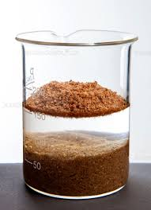
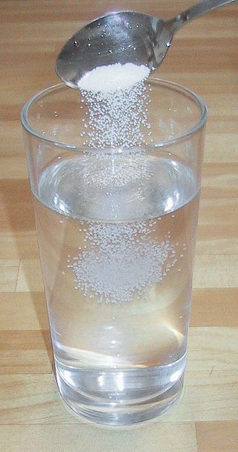
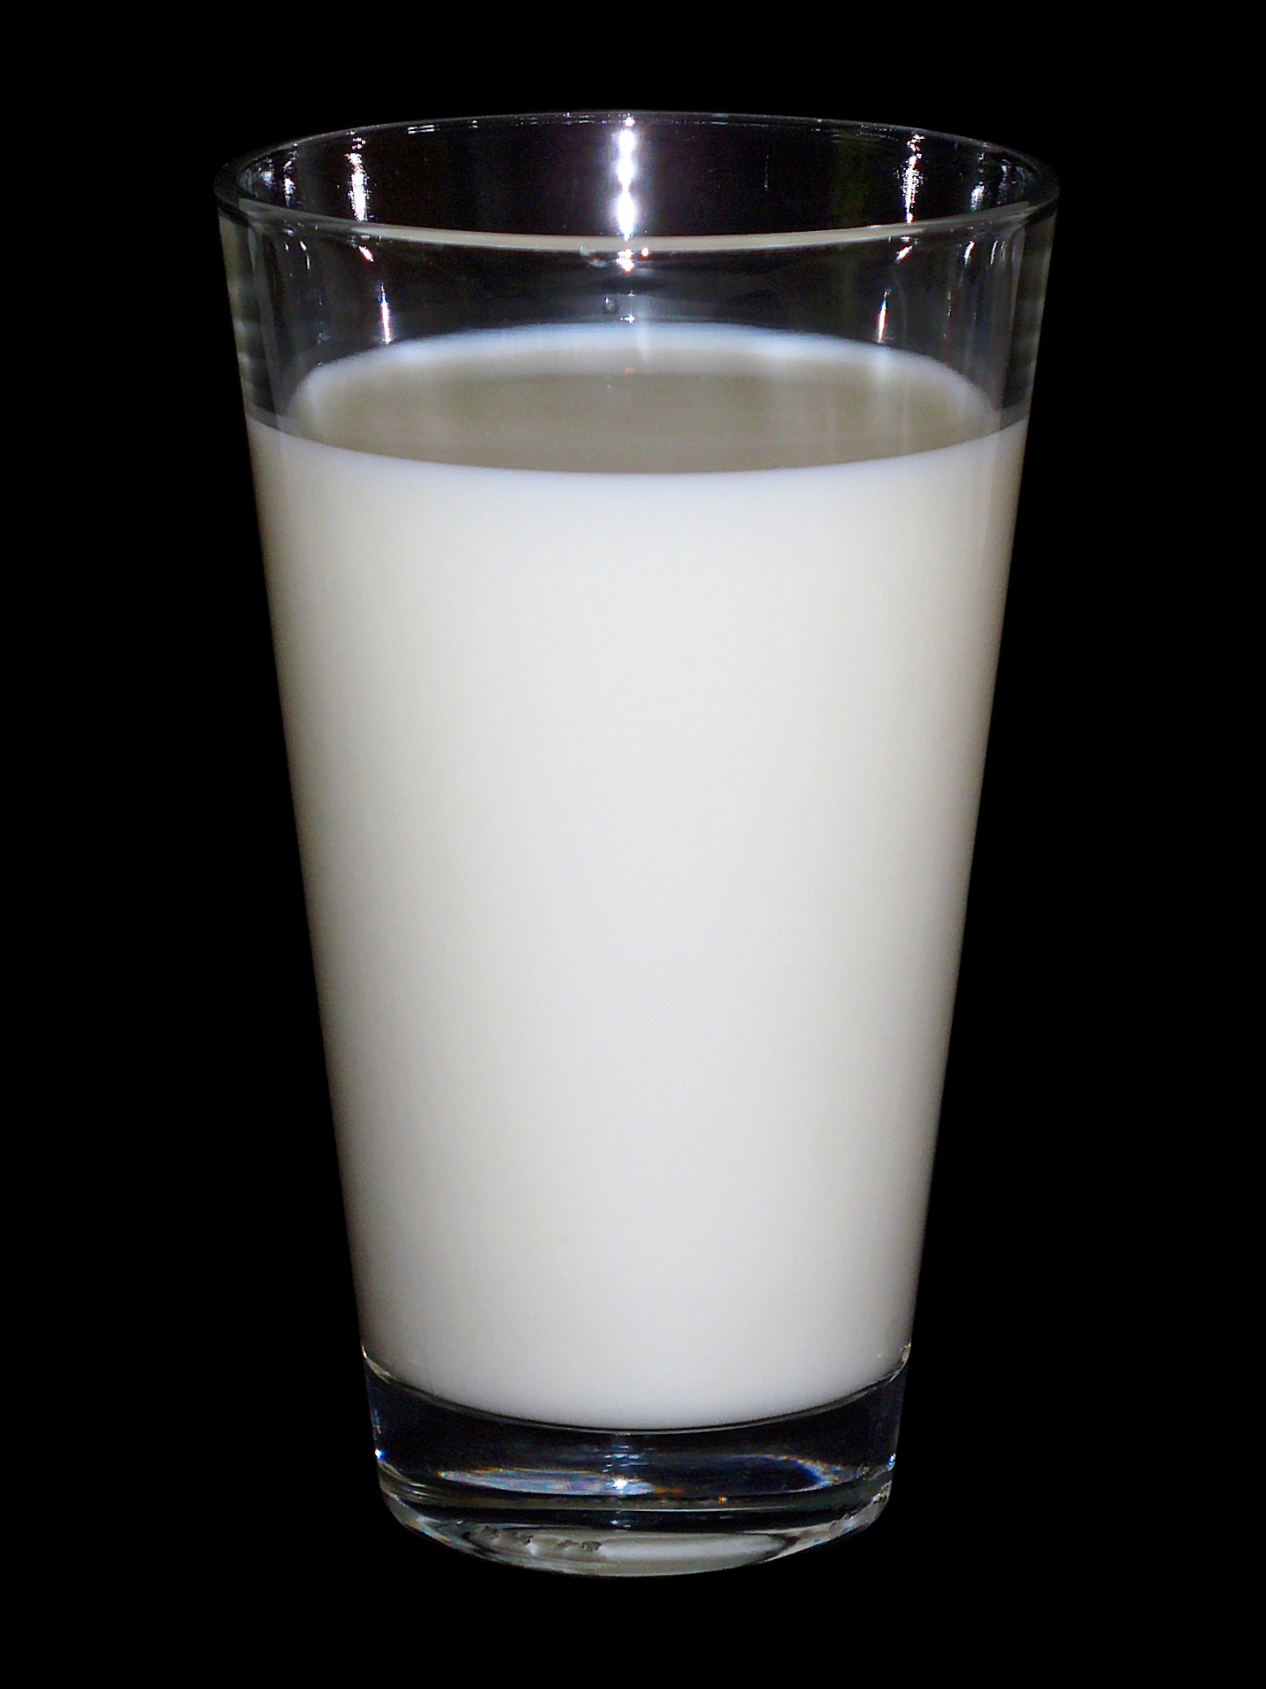
SUSPENSION
TRUE SOLUTION
COLLOIDAL SOLUTION

Slide 11
CHARACTERISTICS OF A MIXTURE
→The constituents of a mixture may be present in any proportion by weight.
→There are no chemical bonds between the constituent of a mixture.
→The mixture can be homogeneous or heterogeneous.
→There is no energy change during the formation of a mixture.
→The constituents of a mixture can be separated by physical methods.
→The mixture does not have a fixed melting and boiling point

Slide 12
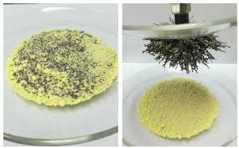
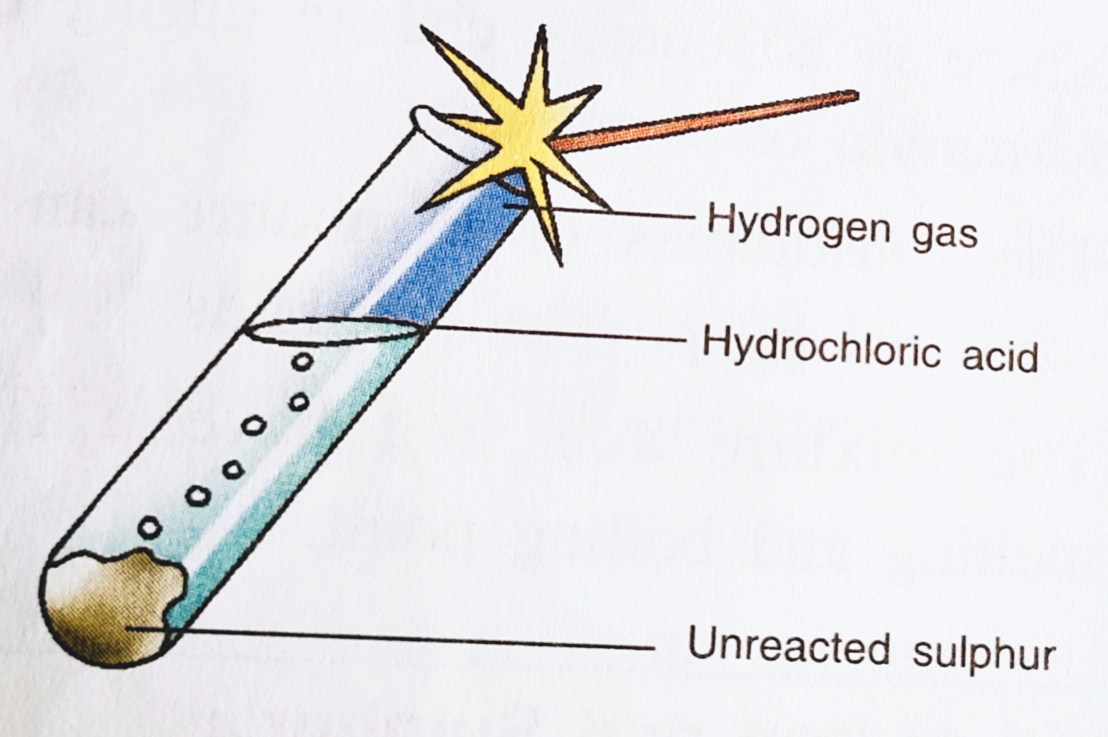
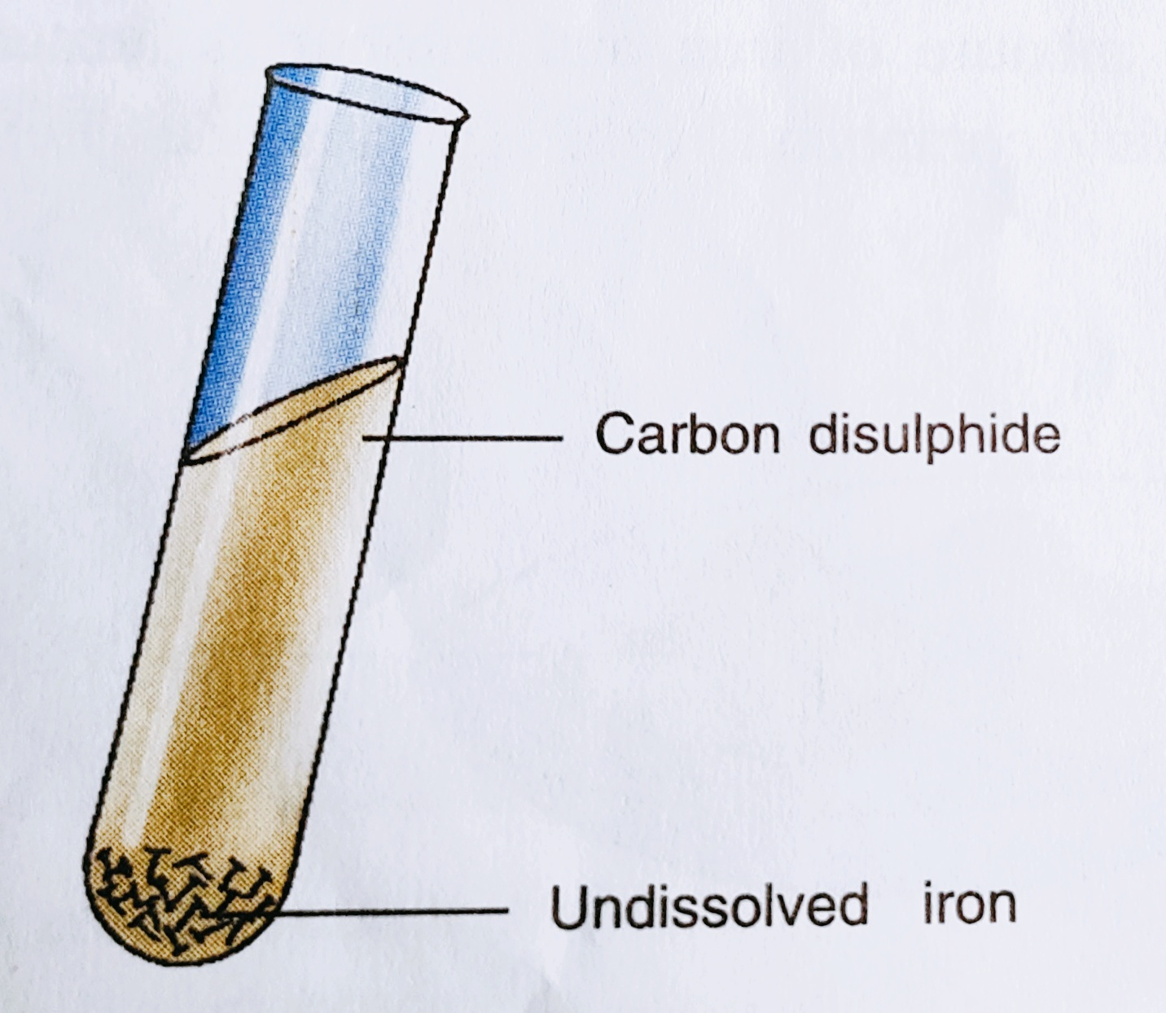
Preparation of a mixture and compound of Iron and Sulphur
MIXTURE
→When grinded powder is taken in a watch glass it is called a mixture.
→When magnet is brought near this mixture the iron fillings cling to the magnet and sulphur remains in the watch glass.
→When HCL acid is added the mixture retains its individual properties and iron of the mixture react to form hydrogen gas which burns with blue flame.
Fe+[S]+2HCl→FeCl2+H2(g)+[S]
→When carbon disulfide is added sulphur dissolves leaving behind iron.

Slide 13
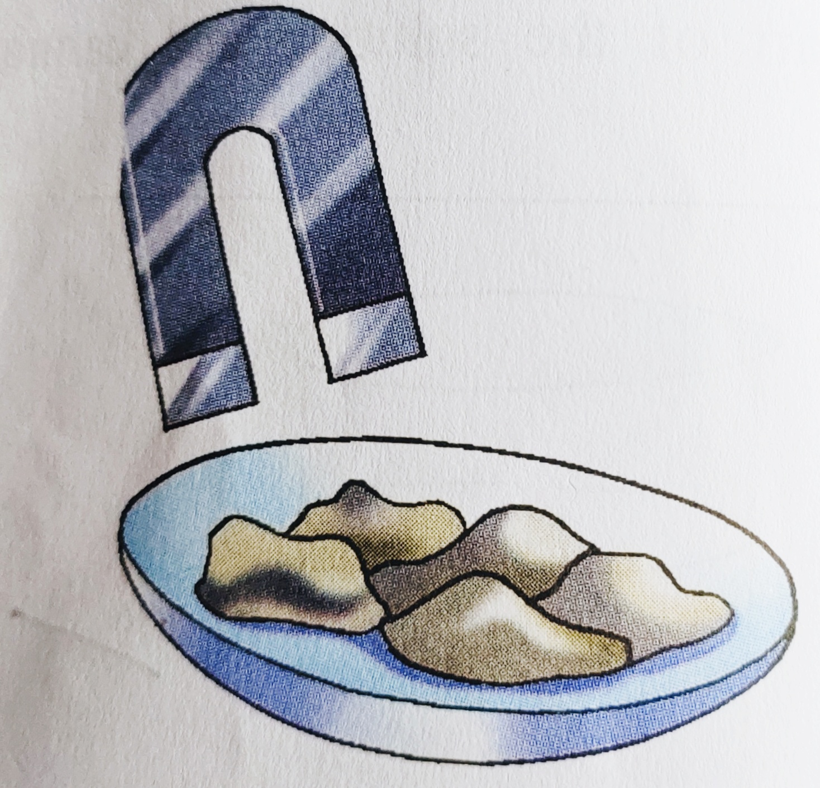
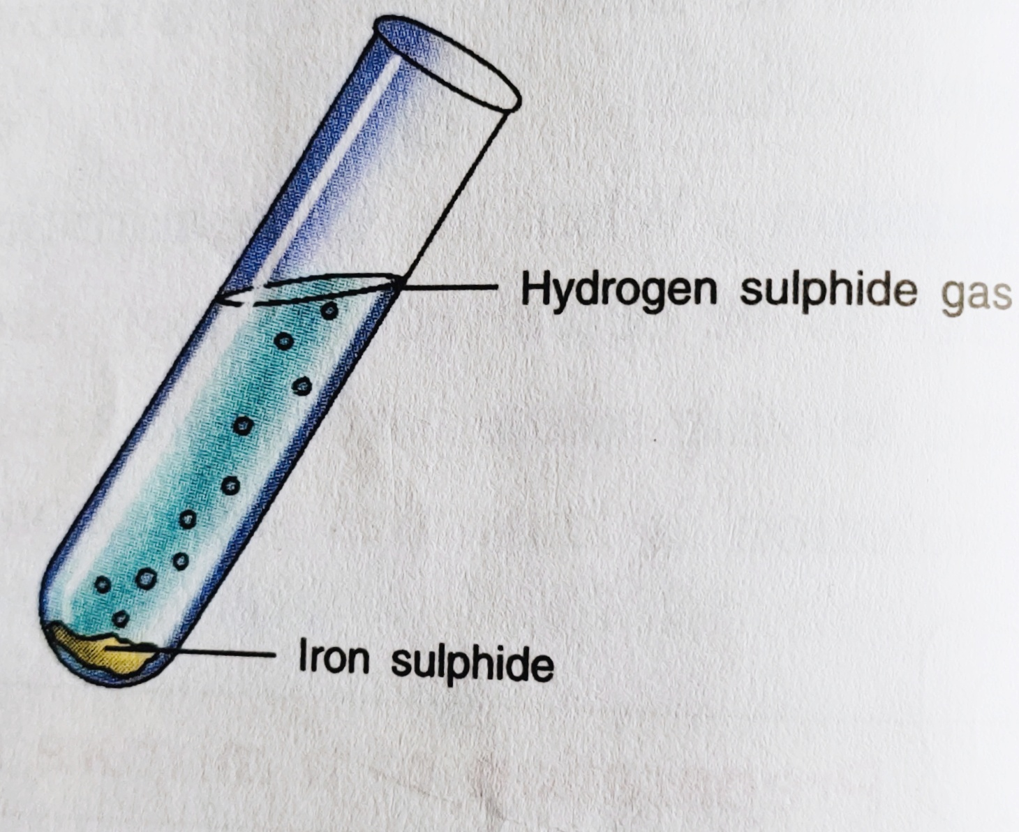
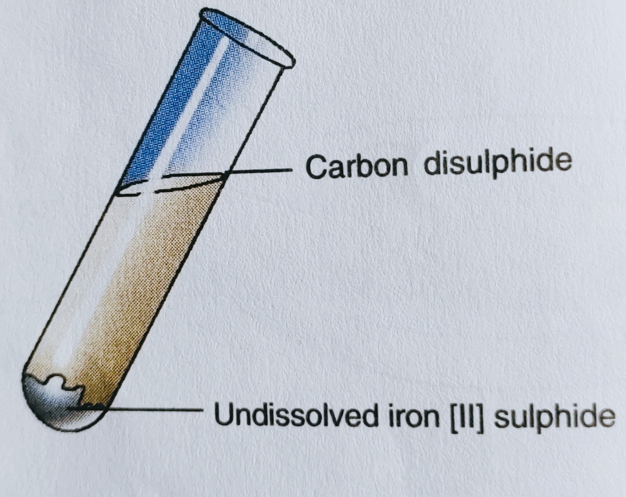
COMPOUND
→When a mixture of iron and sulphur is heated a black shiny compound iron sulphide is formed.
→When the magnet is brought near it, the iron of the iron sulphide remains unaffected.
→When HCL acid is added to the compound it reacts as iron sulphide and liberate hydrogen sulphide gas with rotten egg smell.
FeS+2HCl→FeCl2+H2S(g)
→When carbon disulfide is added to the compound no visual change is observed indicating that the compound is insoluble.

Slide 14
DIFFERENCES BETWEEN A COMPOUND AND A MIXTURE
COMPOUND
MIXTURES
1. A compound is formed from its constituent element as a result of chemical reaction.
2. A compound is always homogeneous in nature.
3. In a Compound the elements are present in a fixed ratio by weight.
4. The properties of a compound are different from those of its elements.
5. The components of a compound can not be separated by physical methods but can be separated by chemical methods only.
6.The formation of a compound from its elements is accompanied by energy change.
1.A mixture is obtained from its (elements, compounds) components as a result of physical change.
2. The mixtures can be homogenous and heterogeneous.
3. In a mixture the components can be present in any ratio.
4. The properties of a mixture lie between those of its components.
5. The components of a mixture can be separated by physical methods.
6. The formation of a mixture from its constituents is not accompanied by energy change.

Slide 15
THANK YOU

